Slide 1
Object Persistence using Hibernate
Hibernate Mapping using XML

Slide 2

What's in This Module
One-to-One With Primary Key XML Mapping
One-to-One With Foreign Key XML Mapping
One-to-Many XML Mapping
One-to-Many Using Join Table XML Mapping
Many-to-Many XML Mapping
Bidirectional Mapping

Slide 3
Create the database and tables
Setting up Spring Tool Suite project
Write the Hibernate Model Classes
Write the Hibernate Mapping Files
Write the Hibernate Configuration File
Code a Test Program
Process Flow

Slide 4
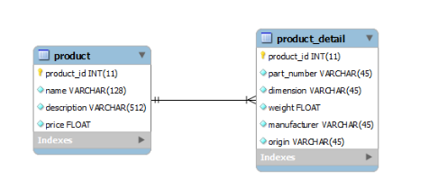
Entity Relationship Diagram

Slide 5

Assisted Practice
Hibernate One-to-One With Primary Key
XML Mapping

Slide 6
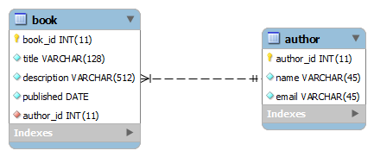
Entity Relationship Diagram

Slide 7
Assisted Practice
Hibernate One-to-One With Foreign Key
XML Mapping

Slide 8
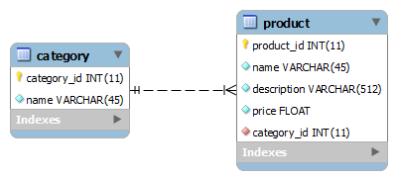
Entity Relationship Diagram

Slide 9
Assisted Practice
Hibernate One-to-Many XML Mapping

Slide 10
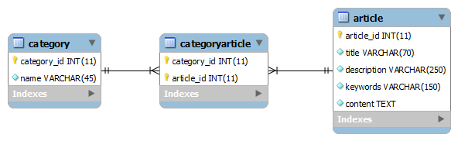
Entity Relationship Diagram

Slide 11
Assisted Practice
One-to-Many Using Join Table XML Mapping

Slide 12
Entity Relationship Diagram

Slide 13
Assisted Practice
Many-to-Many XML Mapping

Slide 14
Assisted Practice
Eager/Lazy Loading In Hibernate

Slide 15
Assisted Practice
Integration of Hibernate with Spring

